Slide 1


Azure Document Intelligence
Author: Phat.Tran
01/2025

Slide 2


TABLE OF CONTENTS
01.
04.
06.
What is Azure Document Intelligence?
Intergrate with .Net Core
<<Content item 6>>
02.
05.
07.
Model types
Pricing
<<Content item 7>>
03.
Train a custom model

Slide 3


What is Azure Document Intelligence?

Slide 4

What is Azure Document Intelligence?
Azure AI Document Intelligence is a cloud-based service by Azure AI that enables you to develop intelligent document processing solutions. By handling large volumes of data from various types of forms and documents, this service helps efficiently manage the speed at which information is collected and processed. It plays a crucial role in enhancing operational efficiency, making accurate data-driven decisions, and driving innovative advancements

Slide 5
Model types

Slide 6

Model types
Azure Document Intelligence offers 3 model types for data extraction from input documents:
Document Analysis: Extracts text, tables, structures, key-value pairs, and named entities from various documents.
Prebuilt Models: Specialized models for specific document types like invoices, ID documents, and more.
Custom Models: Allows training tailored models to classify documents and extract text, structure, or specific fields from forms or custom documents.

Slide 7
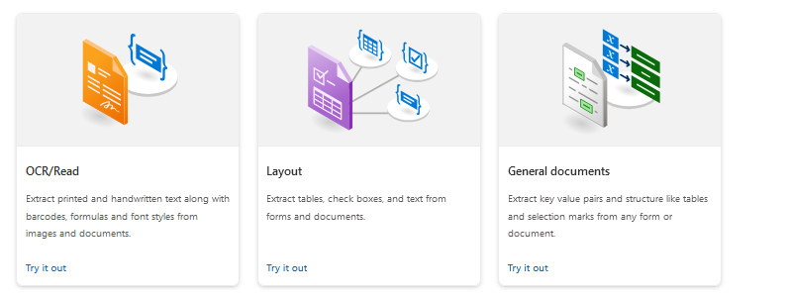
Model types
Document analysis

Slide 8
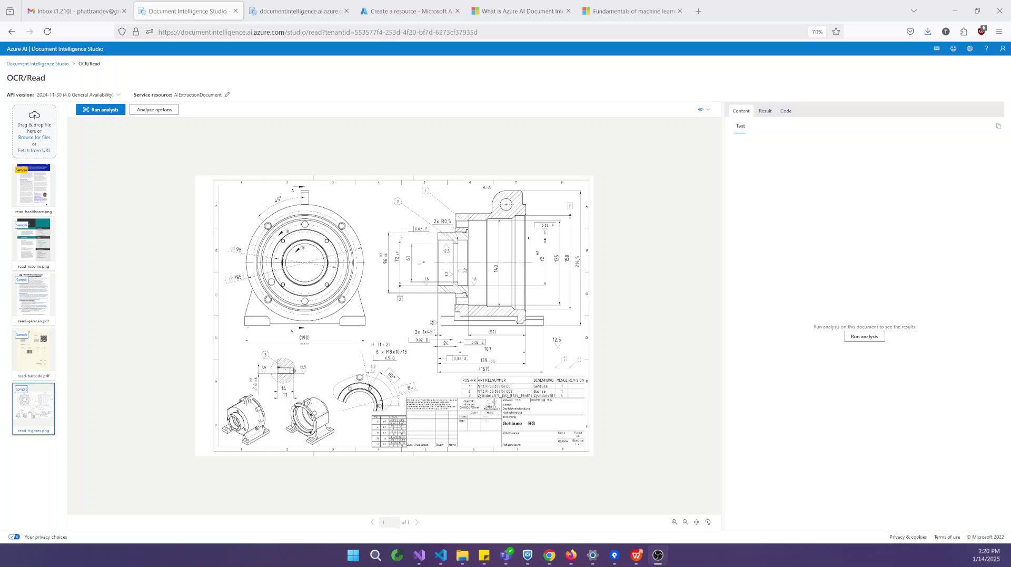
Model types
OCR/Read (Extract text from printed & handwritten)

Slide 9
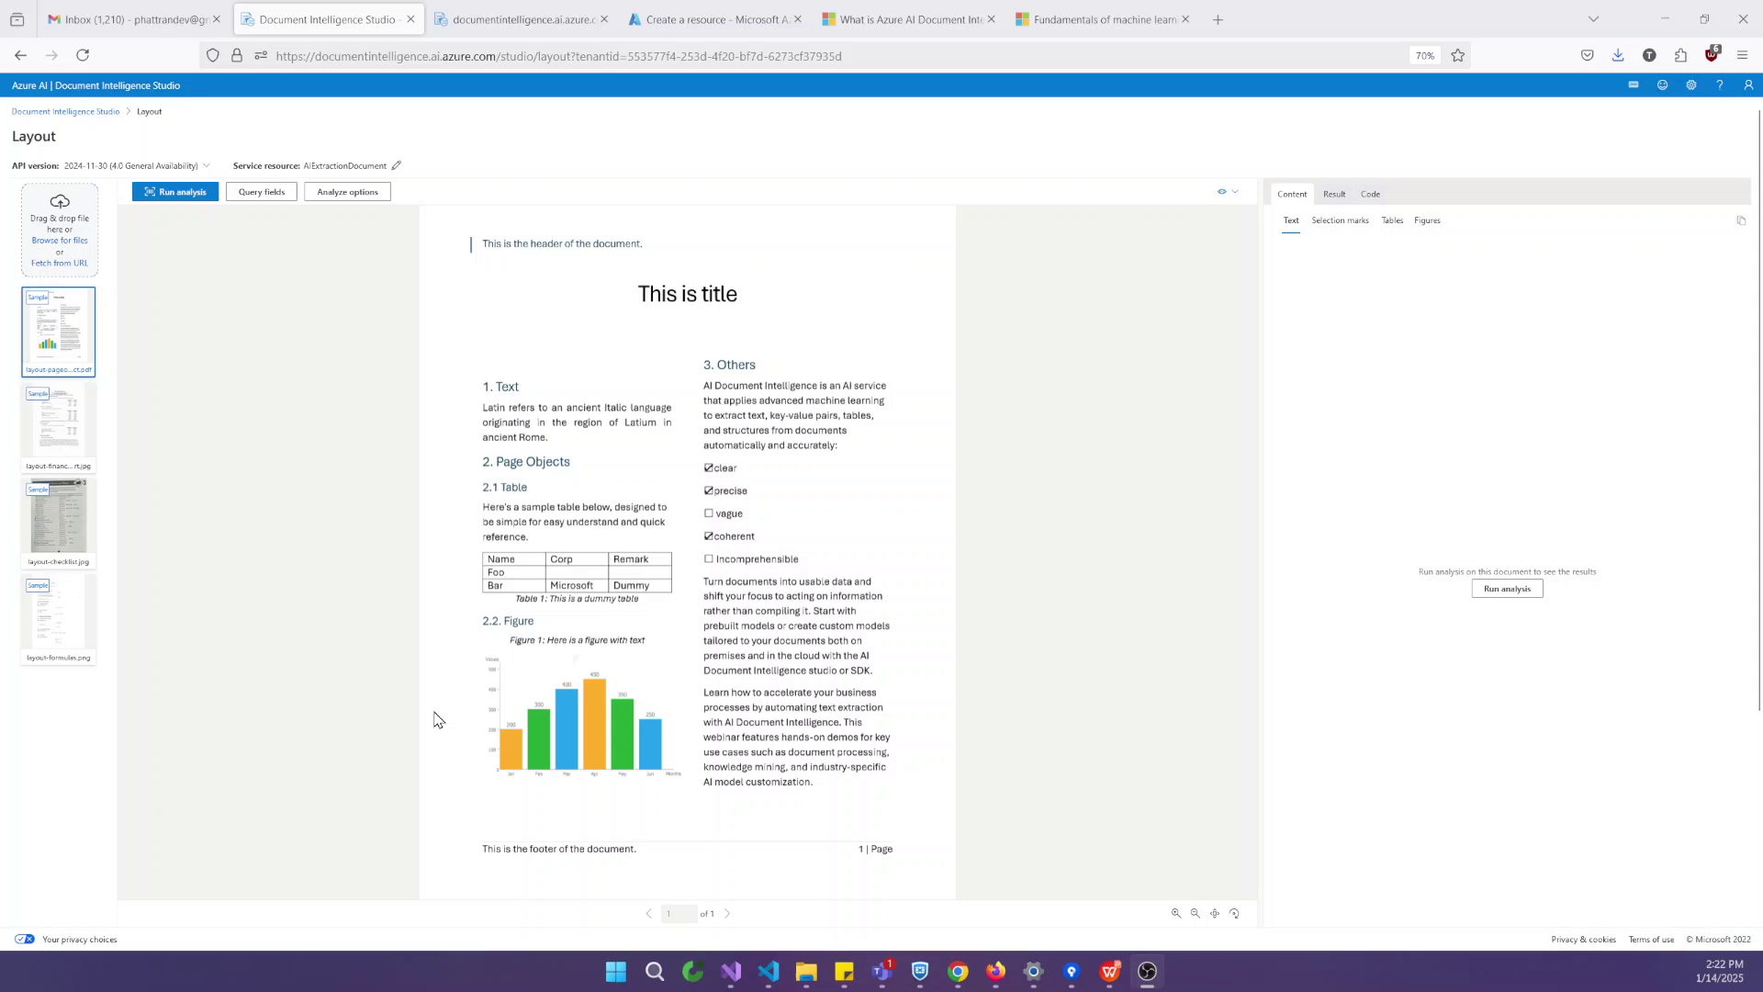
Model types
Layout (Extract data in form tables, check boxes & text))

Slide 10
Model types
General documents (Similar to the Layout model but also extracts key-value pairs along with text and structure.)

Slide 11
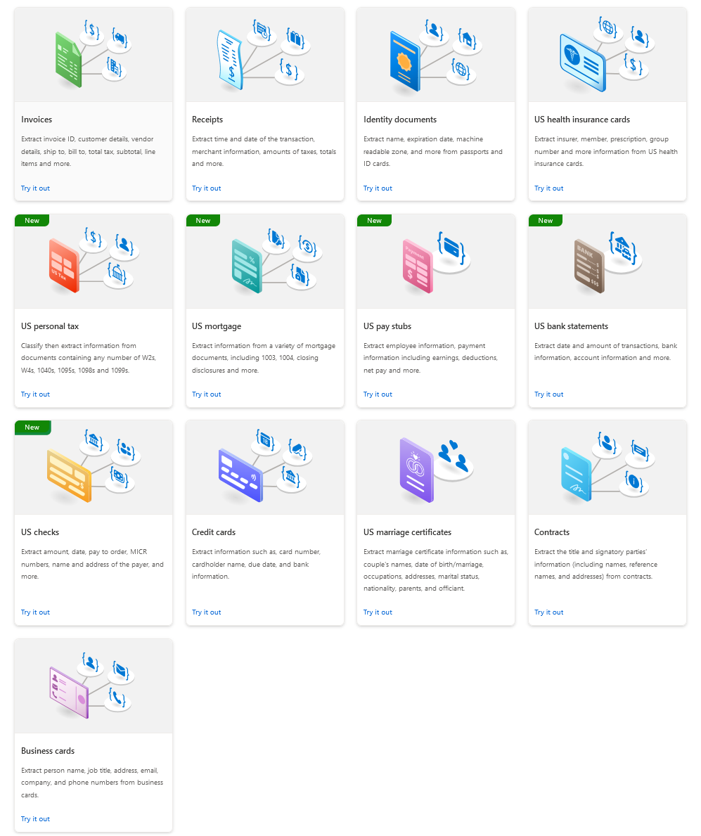
Model types
Prebuilt models
Extract data from unique document types using the following prebuilt models

Slide 12
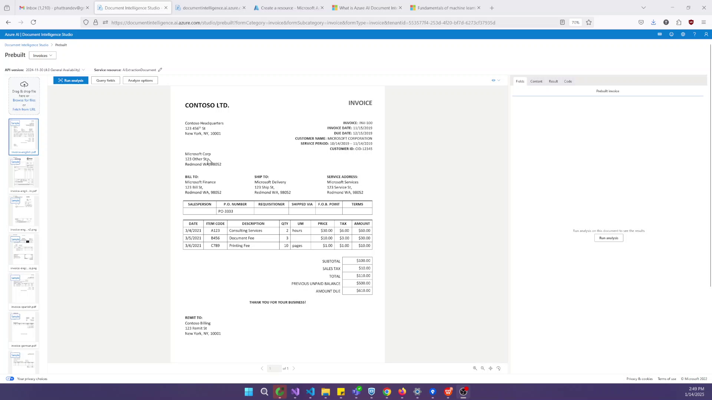
Model types
Prebuilt models

Slide 13
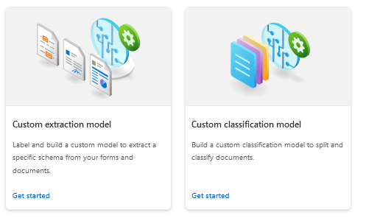
Model types
Custom models

Slide 14
Train a custom model

Slide 15
Train a custom model
Training Types in Azure Document Intelligence:
Neural Training: This approach is ideal for handling unstructured or semi-structured documents. The custom neural (or custom document) model leverages deep learning techniques and a base model trained on a vast collection of documents. When you train this model with a labeled dataset, it fine-tunes or adapts to your specific data, enabling it to handle diverse layouts and formats effectively.
Template Training: This method is best suited for structured documents. The custom template (or custom form) model is designed to work with documents that follow a consistent visual template. Your training dataset should consist of structured documents with a static and predictable layout across all instances. This ensures accurate extraction of labeled data based on the fixed formatting.

Slide 16
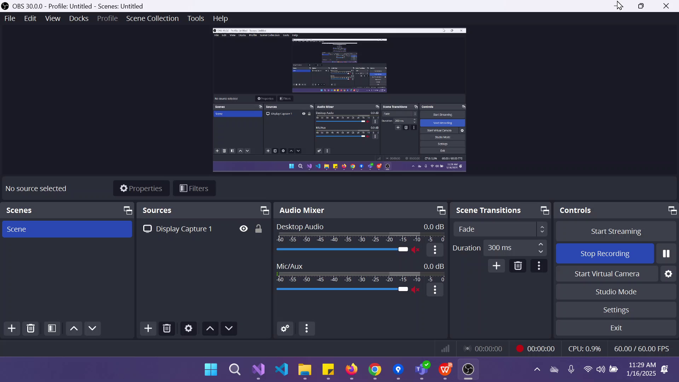
Train a custom model

Slide 17
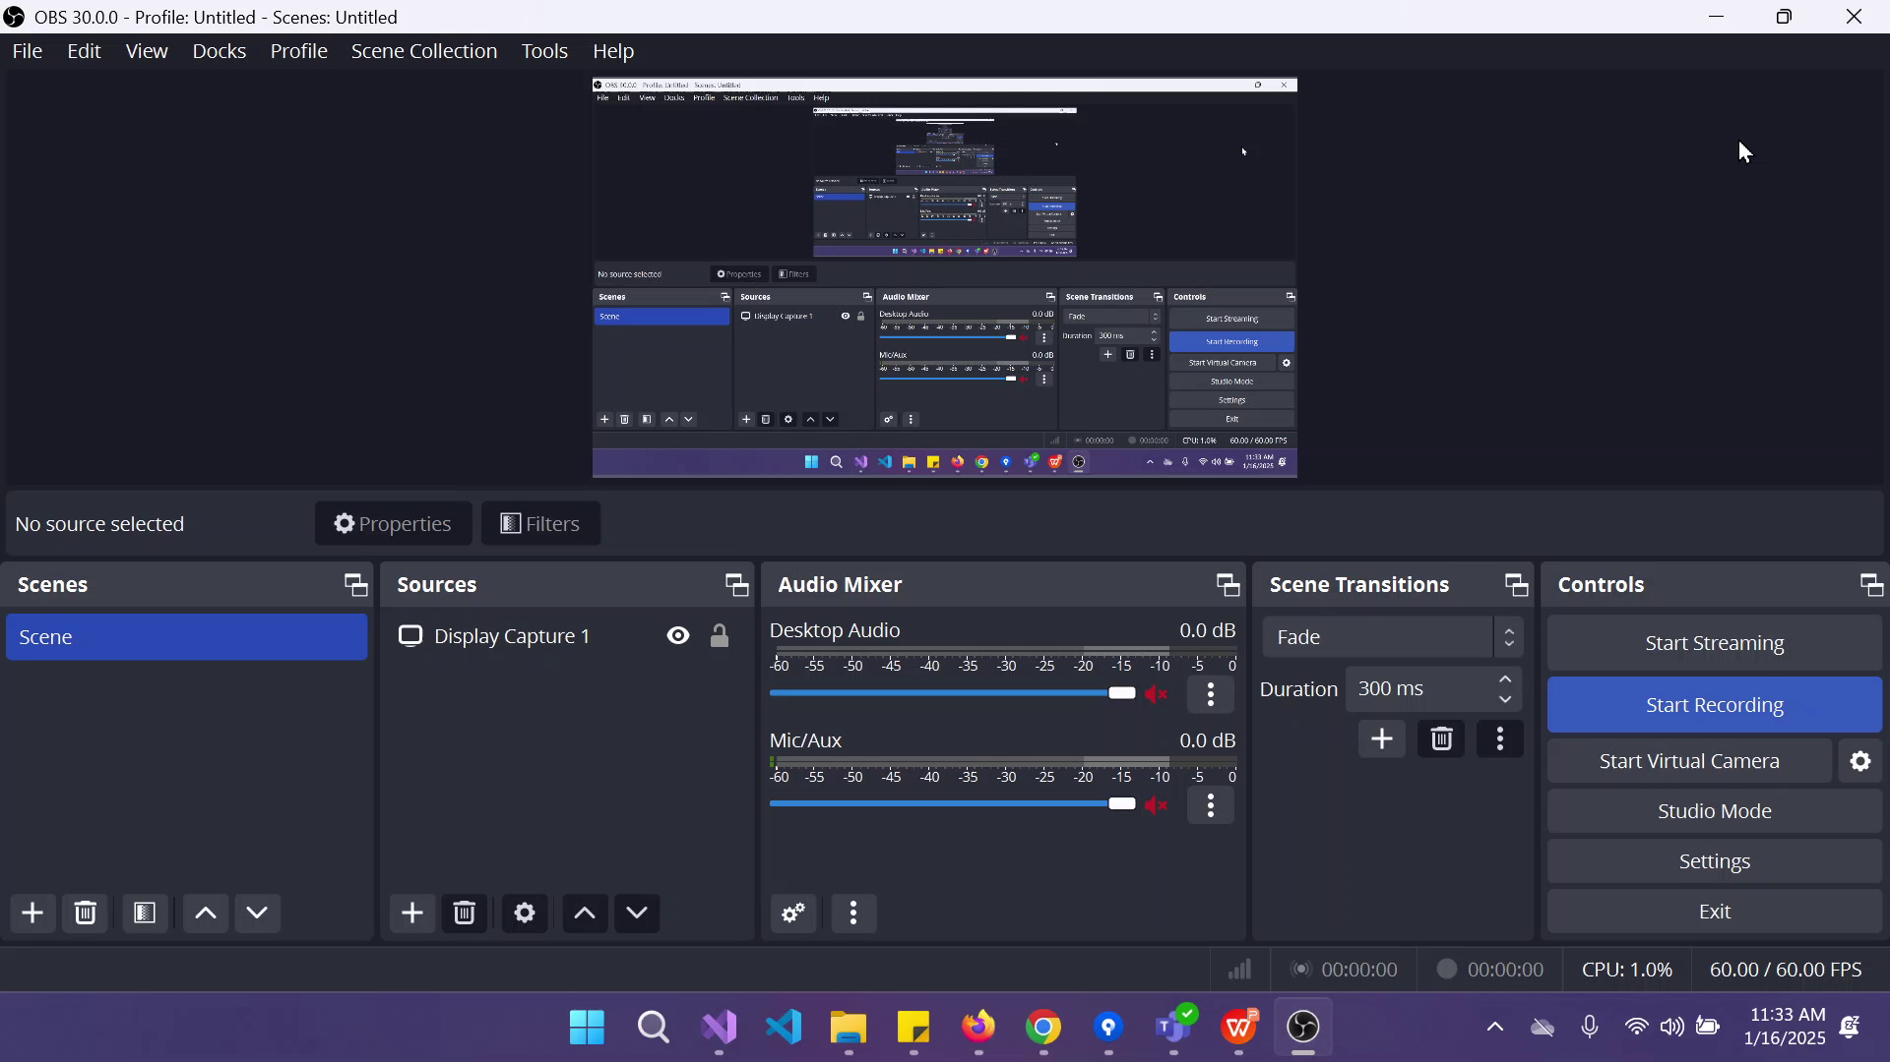
Train a custom model

Slide 18
Q & A

Slide 19

THANK YOU!

